Slide 1

Recommender System on Contractor Business
Richer Ge
Notes:
Homework on week 4

Slide 2

Content
Restatement of the Problem
Recommendation System Setup
Clustering problems and Coordinate dataset
Business and Data Understanding
Data Collection and Pre
API Calls
Mathematical modeling
K-Means
Model evaluation
Pros and Cons

Slide 3
Restatement of the Problem
In a city of your choice, if a contractor is trying to start their own business, where would you recommend that they setup their office?
This is a typical clustering problem with dataset labeled.

Slide 4
Business and Data Understanding
Business Understanding: close to provider and Customer market
Data needed: geo-locational information about specific borough and the neighborhoods in that borough.
We assume it is in “Lixia” in Jinan, China.

Slide 5
Data Preparation
We will need data about different venues in different neighborhoods of that specific borough. In order to gain that information we will use "Foursquare" locational information. A typical request from Foursquare will be in this format:

Slide 6
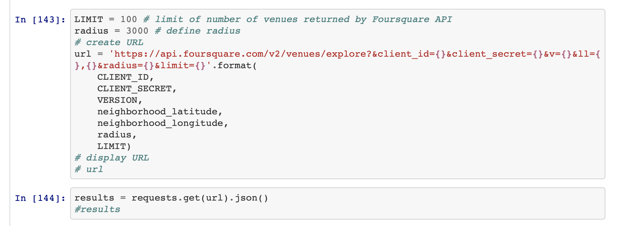
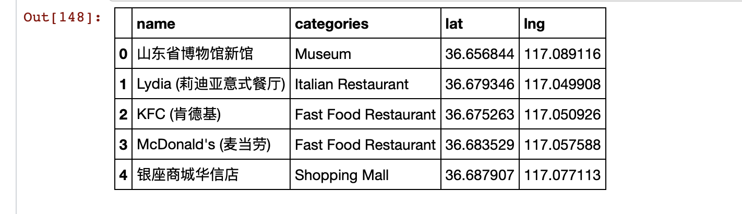

Slide 7
Modeling Part 1
Identifying Postal Codes (and then Neighborhoods) in Jinan.
Connecting to Foursquare and Retrieving Locational Data for Each Venue in Every Neighborhood.
After finding the list of neighborhoods, we then connect to the Foursquare API to gather information about venues inside each and every neighborhood. For each neighborhood, we have chosen the radius to be 3000 meter.

Slide 8
Modeling Part 2
Processing the Retrieved Data and Creating a DataFrome for All the Venues inside Jinan.
One-hot encoding !
Applying one of Machine Learning Techniques (K-Means Clustering)
Now, we focus on the centers of clusters and compare them for their “Total Types”. The group which its center has the highest "Total Sum" will be our best recommendation to the contractor. {Note: Total Sum = Sum of Total Types}. This algorithm although is pretty straightforward yet is strongly powerful.

Slide 9
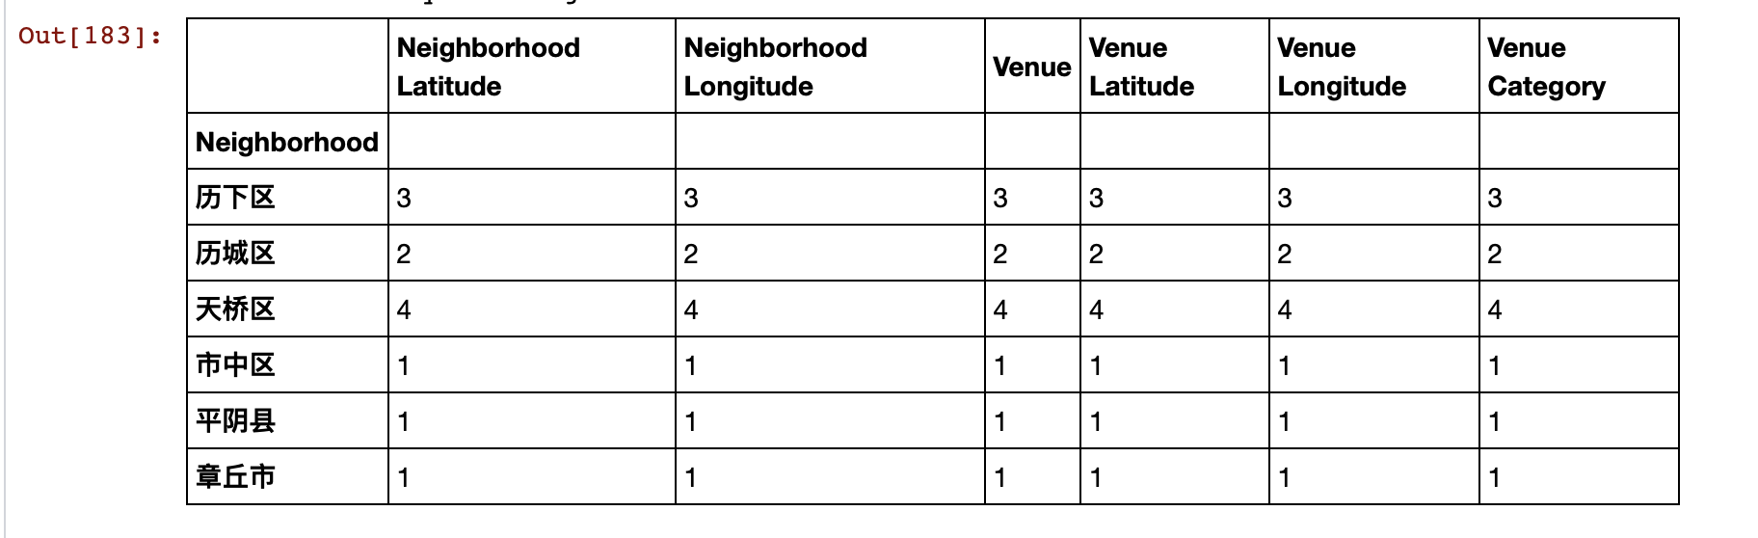
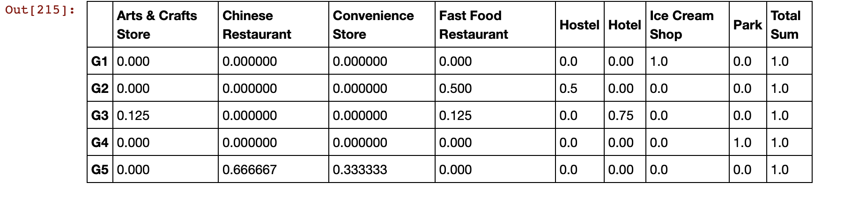

Slide 10
Evaluation
Although some techniques are quite straightforward but powerful.
Although this is quite simple, further more I will use more structural datasets to evaluate NBA games to improve my data analysis ability.
Hard work pays off!

